Slide 1
What is a Threat?
A threat in cloud security is a potential negative action or event facilitated by a
vulnerability that results in an unwanted impact to a computer system or application.
There are 4 types of threats:
Dictionary Attack
Disruptive Attack
Ransomware
Data Breach

Slide 2
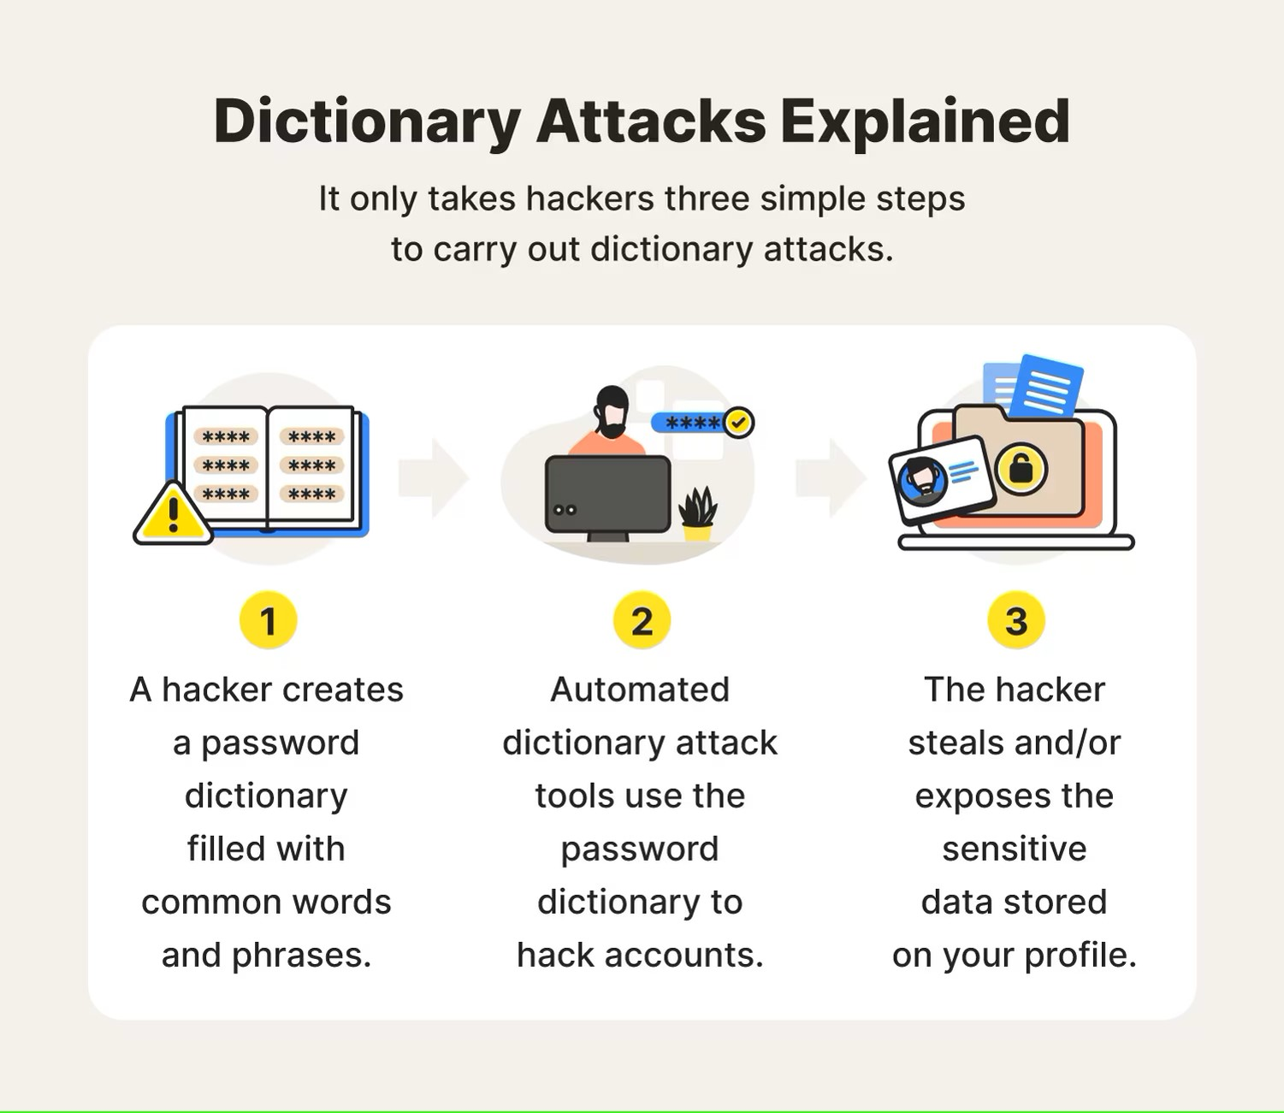
Dictionary Attack
Attacker attempts to steal an identity by brute forcing into a target accounts by enumerating over a large number of known passwords.
Dictionary hackers use what are known as password dictionaries. These are lists of common words and phrases that people may quickly think of when creating an account. They’ll include simple phrases like “qwerty” and combinations like “1234.”
The difference between a dictionary attack vs. a brute force attack lies in the type of passwords tested against your accounts. Brute force attacks try short and random passwords containing various letters, numbers, and characters.

Slide 3
Disruptive attacks
An attack which attempts to disrupt a computer system or computer network.
An example of Disruptive attack is DDoS.

Slide 4
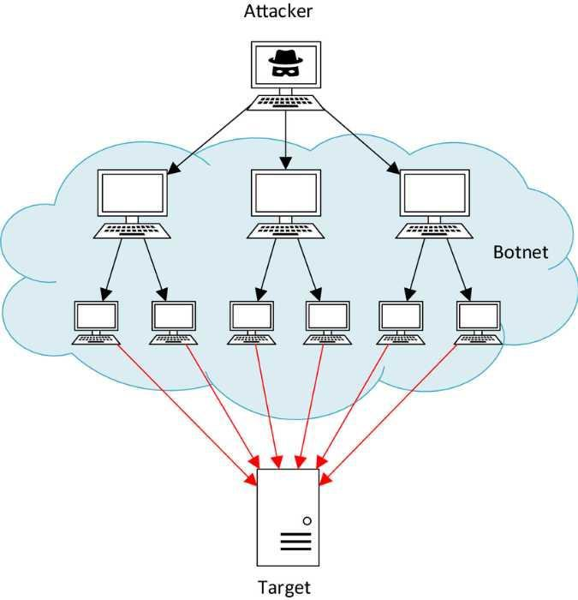
Distributed Denial of Service (DDoS)
DDoS Attack means "Distributed Denial-of-Service (DDoS) Attack" and it is a cybercrime in which the attacker floods a server with internet traffic to prevent users from accessing connected online services and sites.
DDoS attacks use botnet, to flood the targeted system with overwhelming amounts of traffic. By sending multiple requests simultaneously from numerous sources, the attacker can overload the target’s resources and prevent legitimate users from accessing it.

